Slide 1
EOC Situation Update
Emergency Management Agency
Roll Call
Impacted Area
Weather Forecast
Ongoing Response
Civilian Impacts
Hospital Data
Community Lifeline Assessment
Resource Requests
Planning Priorities
Timeline
Closing Comments
Notes:
The EOC Situation Update is intended for multiple uses:
EOC Activation - Capture initial information and brief EOC representatives upon arrival
Shift Change - Transfer information between shifts over multiple operational periods
Upon Request - Provide update to Elected and Senior Officials
Save the file under the title:
YearMonthDay_Miami County EOC Situation Update_Incident
e.g. 20220512_Miami County EOC Situation Update_Tornado
For events that extend over multiple operational periods: update the slides and save under a new title corresponding with the new date.

Slide 2
Roll Call
Emergency Management Agency
EMA: names
Law Enforcement
  organization and name
Fire and EMS
Public Health
Mass Care
Public Works
Transportation
Communications
Auditor
County Commissioners
OH EMA Regional Liaison
Notes:
Record the names of those in attendance

Slide 3
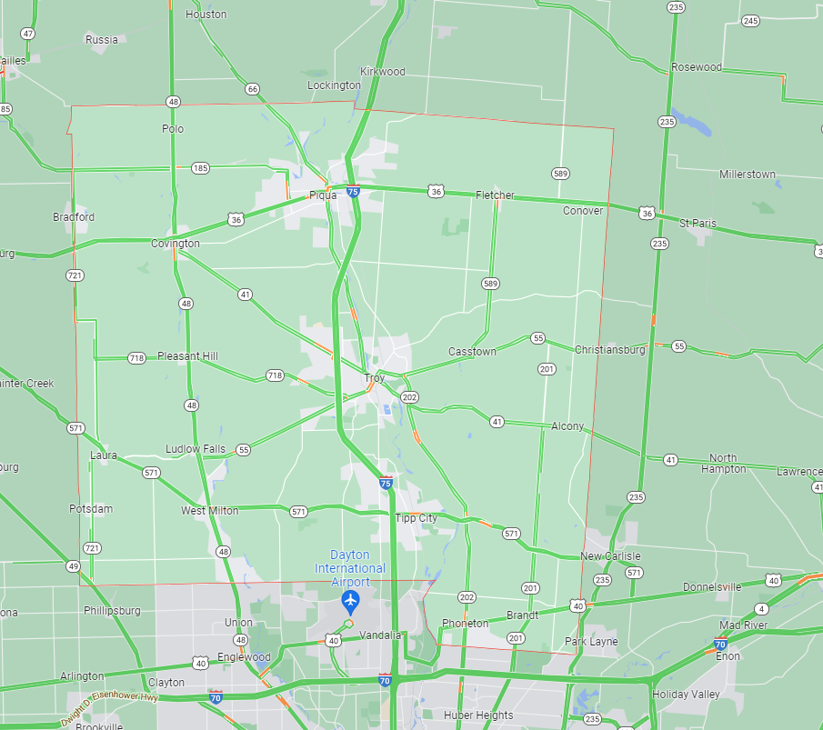
Area Impacted
Location
- Jurisdiction
- Address
Incident Type
- e.g. tornado
Time of Occurrence
- date and time
Severity Trend
UP
DOWN
STABLE
Notes:
Add as much detail as possible. Initial versions of this may contain only partial information.
Can be listed as address or a general area.
Consult SPILLMAN for locations of specific incidents
- Login required thru IT
Check OH EMA
https://display-resources-oema.hub.arcgis.com/

Slide 4
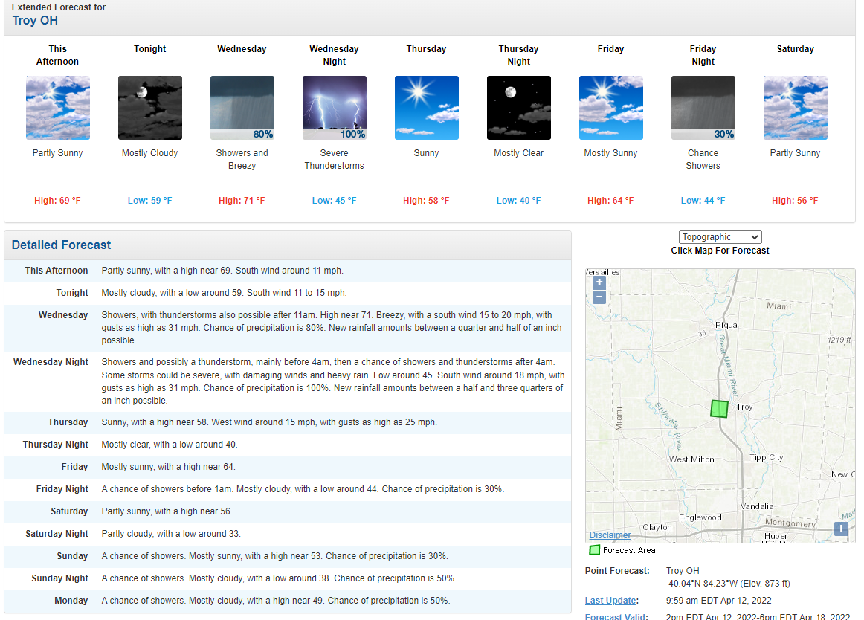
Weather Forecast
Notes:
Consult National Weather Service:
https://www.weather.gov/

Slide 5
Infrastructure Impacts
Structures
- damaged
- destroyed
Roadways
- closed
- blocked
Utilities
- outages
Communications
- cell coverage
Medical Facilities
- damages
- capacity
Notes:
Add as much detail as possible. Initial versions of this may contain only partial information.
Consult SPILLMAN
Consult AES and Pioneer Power Outage Maps:
https://myprofile.aes-ohio.com/Outages/Outages.html
https://www.pioneerec.com/outage-center
The Lifeline Assessment will expand in detail on this information.

Slide 6
Response Agencies
Incident Command Post
- Incident Commander
- Location / Address
Response Agencies
- list
Mutual Aid Agencies
- list
Communications
- MARCS talkgroups
- Amateur Radio (RACES)
First Responders | Reported this period | Incident total
Fatalities
Injuries
Missing
Notes:
Get input from Coordination Section Chief and EOC Functional Area representatives:
what agencies area deployed?
Where are they?
What are they doing?
Any impacts on first responders?

Slide 7
Incident Impacts
Civilians | Reported this period | Incident total
Fatalities
Injuries
Missing
Ongoing Operations
Search and Rescue | Y/N | Agency conducting
Evacuation | Y/N | Geographic location
Shelter-in-place | Y/N | Geographic location
Shelter | Y/N | Address
Family Reunification Center | Y/N | Address
Family Assistance Center | Y/N | Address
Volunteer Center | Y/N | Address
Donation Center | Y/N | Address
Notes:
Get input from Coordination Section Chief and EOC Functional Area representatives:
Document the major response operations that are ongoing

Slide 8
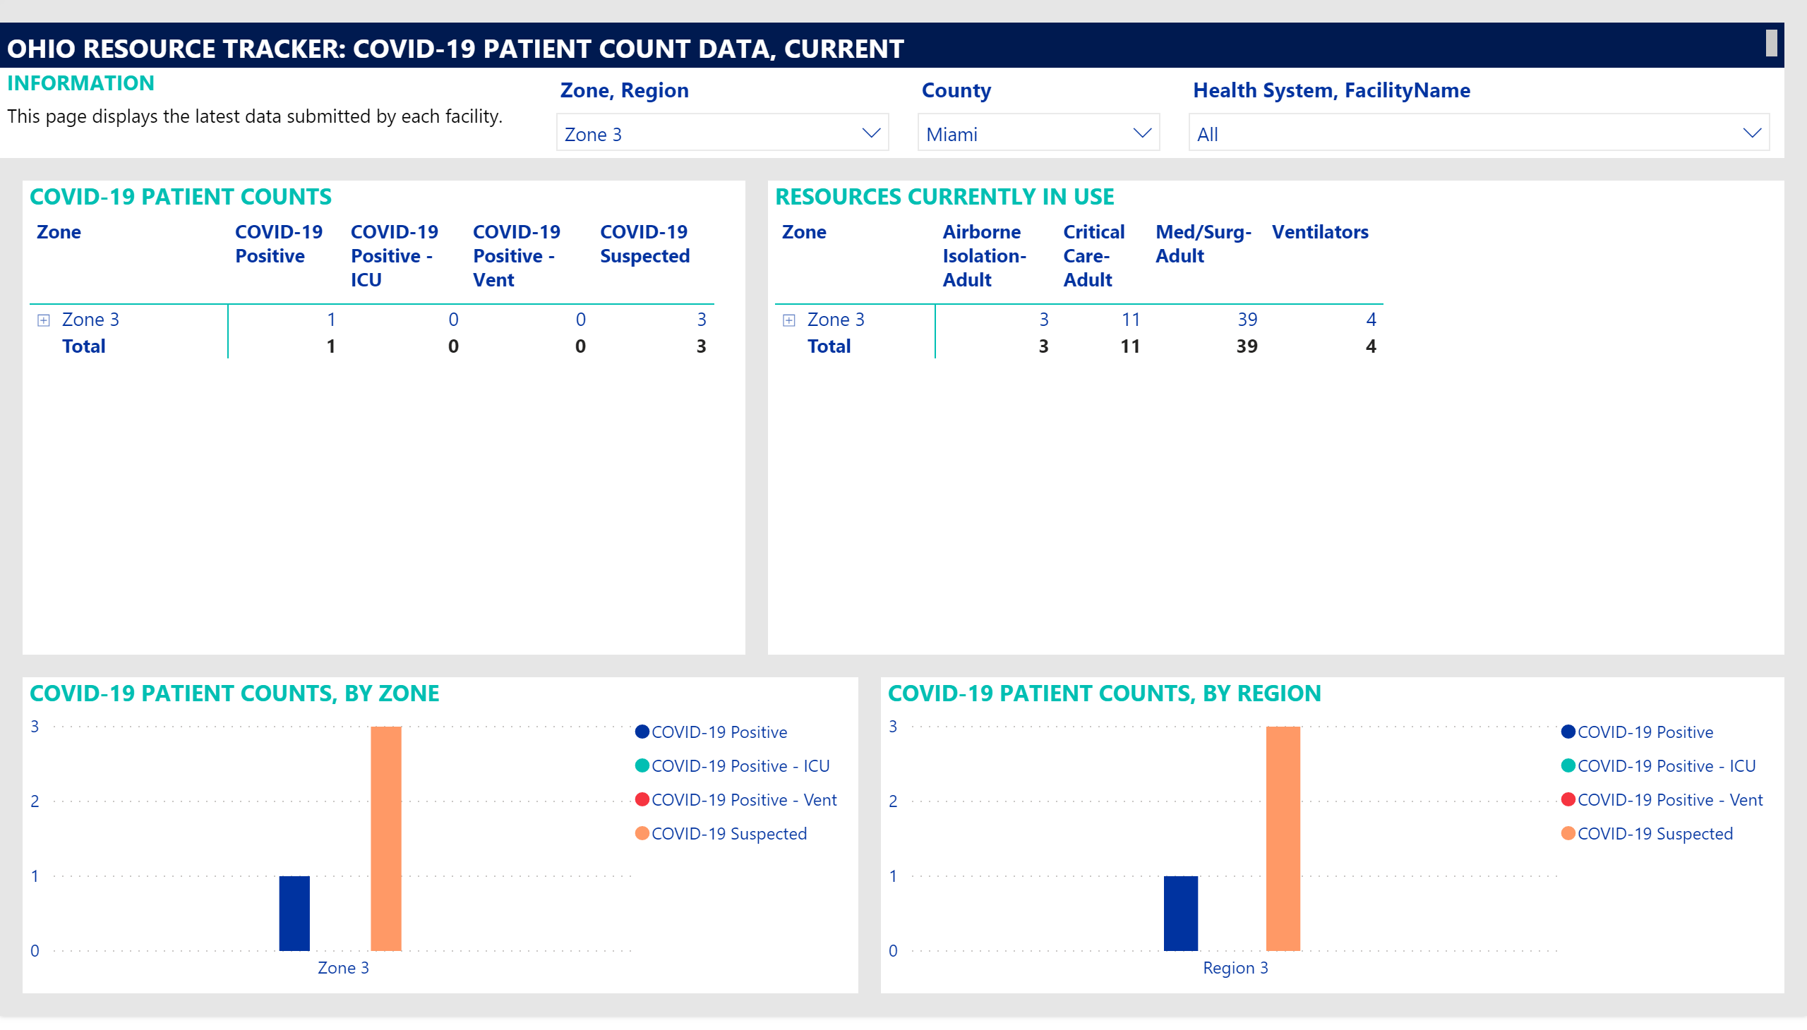
Hospital Data
for example only
Notes:
Consult Surgenet and OHTRAC (Regional Healthcare facility data)
- Needs login
https://ohio.surgenet.org/SignIn.aspx
ODH and County Public Health might have other data sources.

Slide 9







Overall Lifeline Assessment
UNSTABLE
for example only
STABILIZING
STABLE
Notes:
This will not be included in the early versions of the briefing.
Can include if the detailed Lifeline Assessment has been completed.

Slide 10



































Lifeline Icons
Notes:
This is a hidden slide that contains ICONs for use on other slides.

Slide 11





Any lifelines not fully green
Food | Water | Shelter | Agriculture
for example only
Comments
Notes:
This will not be included in the early versions of the briefing.
Can include if the detailed Lifeline Assessment has been completed.
Only show those lifelines that have been impacted.
Comment on the impact and actions being taken/plan to restore to GREEN.

Slide 12
Resource Requests
Resource | Time needed | Location | POC | Contact info
Notes:
Summarize the resource requests.
This should be provided by the Coordination Section Chief
Highlights:
Red – no source identified or confirmed
Yellow – source identified but not delivered yet
Green – delivery complete
Leave without color if still working on the request

Slide 13
Planning Priorities
Objective 1: Lifeline / Component / Subcomponent
Activities
Participants
Timing
Objective 2: Lifeline / Component / Subcomponent
Activities
Participants
Timing
Objective 3: Lifeline / Component / Subcomponent
Activities
Participants
Timing
Notes:
Initially this may be a list of what needs to be done in the immediate aftermath of the emergency.
Later on it may be aligned with the Lifeline Assessment.

Slide 14
Timeline
Event | Time | Location | POC
Update briefing
Shift change
Damage Assessment
Notes:
Include events specifically for the EOC and the major events happening out in the community and/or related to incident command and response actions

Slide 15
Emergency Management Agency
For subsequent briefings

Slide 16
Significant Events (last 24 hours)
Emergency Management Agency
1. Action
2. Event
3. Accomplishment
Etc.
Notes:
If this is used move it to Slide #8

Slide 17
Damage Assessment
Emergency Management Agency
Structure | Affected | Minor Damage | Major Damage | Destroyed
Single residence
Multi-residence
Commercial property
Public Facility
Other
Notes:
If this is used move it to Slide #8

